Slide 1
ARTIFICIAL INTELLIGENCE
Dr T V RAJINI KANTH
PROFESSOR & DEAN R&D
SNIST

Slide 2
UNIT-III
Representation,
Syntax and Semantics of First-Order Logic,
Using First Order Logic,
Knowledge Engineering in First-Order Logic.
Inference in First-Order Logic:
Propositional vs. First-Order Inference,
Unification and Lifting,
Forward Chaining,
Backward Chaining,
Resolution.
Knowledge Representation: Ontological Engineering,
Categories and Objects,
Events.

Slide 3
Introduction
How a knowledge-based agent could represent the world in which it operates and deduce what actions to take showed.
Propositional logic is used as our representation language because it sufficed to illustrate the basic concepts of logic and knowledge-based agents.
Propositional logic is too puny a language to represent knowledge of complex environments in a concise way.
First-order logic, is sufficiently expressive to represent a good deal of our commonsense knowledge.
It also either subsumes or forms the foundation of many other representation languages and has been studied intensively for many decades.

Slide 4
REPRESENTATION REVISITED
Discuss the nature of representation languages to motivate the development of first-order logic, a much more expressive language than the propositional logic.
Propositional logic and at other kinds of languages to understand what works and what fails.
Programming languages (such as C++ or Java or Lisp) are by far the largest class of formal languages in common use.
Programs themselves represent, in a direct sense, only computational processes.
Data structures within programs can represent facts; Ex: a program could use a 4 × 4 array to represent the contents of the wumpus world.
Programming language statement World[2,2]← Pit is a fairly natural way to assert that there is a pit in square [2,2].
Programming languages lack is any general mechanism for deriving facts from other facts; each update to a data structure is done by a domain-specific procedure whose details are derived by the programmer from his or her own knowledge of the domain.
This procedural approach can be contrasted with the declarative nature of propositional logic, in which knowledge and inference are separate, and inference is entirely domain independent.
Propositional logic is a declarative language because its semantics is based on a truth relation between sentences and possible worlds.
It also has sufficient expressive power to deal with partial information, using disjunction and negation.
Propositional logic has a third property that is desirable in representation languages, namely, compositionality

Slide 5
The language of thought: Natural languages (such as English or Spanish) are very expressive indeed.
Natural language is viewed as a declarative knowledge representation language.
The modern view of natural language is that it serves a as a medium for communication rather than pure representation.
Meaning of the sentence depends both on the sentence itself and on the context in which the sentence was spoken.
Natural languages also suffer from ambiguity, a problem for a representation language.
Language also seems to influence thought through seemingly arbitrary grammatical features such as the gender of nouns.
In a first-order logic reasoning system that uses CNF, linguistic form “¬(A ∨ B)” and “¬A ∧ ¬B” are the same because two sentences are stored as the same canonical CNF form.
Can we do that with the human brain? Until recently the answer was “no,” but now it is “maybe.”
From the viewpoint of formal logic, representing the same knowledge in two different ways makes absolutely no difference; the same facts will be derivable from either representation.
Combining the best of formal and natural languages: We can adopt the foundation of propositional logic—a declarative, compositional semantics that is context-independent and unambiguous—and build a more expressive logic on that foundation, borrowing representational ideas from natural language while avoiding its drawbacks.
Ex: of objects, relations, and functions:
• Objects: people, houses, numbers, theories, Ronald McDonald, colors, baseball games, wars, centuries ...
• Relations: these can be unary relations or properties such as red, round, bogus, prime, multistoried ..., or more general n-ary relations such as brother of, bigger than, inside, part of, has color, occurred after, owns, comes between, ...
• Functions: father of, best friend, third inning of, one more than, beginning of ...

Slide 6
• “One plus two equals three.”
Objects: one, two, three, one plus two; Relation: equals; Function: plus. (“One plus two” is a name for the object that is obtained by applying the function “plus” to the objects “one” and “two.” “Three” is another name for this object.)
• “Squares neighboring the wumpus are smelly.”
Objects: wumpus, squares; Property: smelly; Relation: neighboring.
The language of first-order logic, whose syntax and semantics is built around objects and relations.
It has been so important to mathematics, philosophy, and artificial intelligence precisely because those fields—and indeed, much of everyday human existence—can be usefully thought of as dealing with objects and the relations among them.
First-order logic can also express facts about some or all of the objects in the universe.
This enables one to represent general laws or rules, such as the statement “Squares neighboring the wumpus are smelly.”
The primary difference between propositional and first-order logic lies in the ontological commitment made by each language—i.e., what it assumes about the nature of reality.
Each fact can be in one of two states: true or false, and each model assigns true or false to each proposition symbol
First-order logic assumes more; namely, that the world consists of objects with certain relations among them that do or do not hold
Higher-order logic views the relations and functions referred to by first-order logic as objects in themselves.

Slide 7
SYNTAX AND SEMANTICS OF FIRST-ORDER LOGIC
Possible worlds of first-order logic reflect the ontological commitment to objects and relations.
Models for first-order logic are the models of a logical language are the formal structures that constitute the possible worlds under consideration.
Each model links the vocabulary of the logical sentences to elements of the possible world, so that the truth of any sentence can be determined.
Models for propositional logic link proposition symbols to predefined truth values.
Models for first-order logic are much more interesting.
First, they have objects in them! The domain of a model is the set of objects or domain elements it contains.
The domain is required to be nonempty—every possible world must contain at least one object.
Figure 8.2 shows a model with five objects: Richard the Lionheart, King of England from 1189 to 1199; his younger brother, the evil King John, who ruled from 1199 to 1215; the left legs of Richard and John; and a crown.
The objects in the model may be related in various ways.
In the figure, Richard and TUPLE John are brothers.
A relation is just the set of tuples of objects that are related. (A tuple is a collection of objects arranged in a fixed order and is written with angle brackets surrounding the objects.)
Thus, the brotherhood relation in this model is the set
{ Richard the Lionheart, King John, King John, Richard the Lionheart } . (8.1)

Slide 8
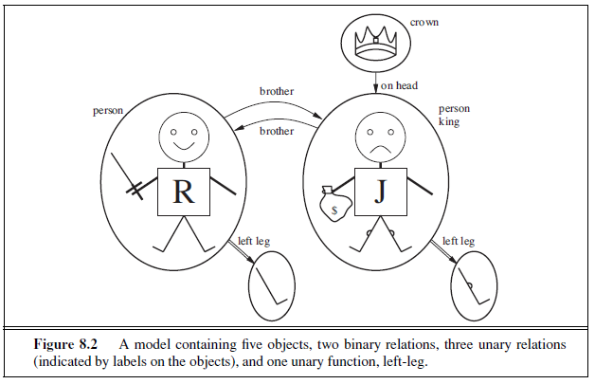
The crown is on King John’s head, so the “on head” relation contains just one tuple, the crown, King John.
The “brother” and “on head” relations are binary relations—that is, they relate pairs of objects.
The model contains unary relations, or properties: the “person” property is true of both Richard and John; the “king” property is true only of John (presumably because Richard is dead at this point); and the “crown” property is true only of the crown.
Certain kinds of relationships are best considered as functions, in that a given object must be related to exactly one object in this way.
Ex: each person has one left leg, so the model has a unary “left leg” function that includes the following mappings:
Richard the Lionheart → Richard’s left leg
King John → John’s left leg . (8.2)

Slide 9
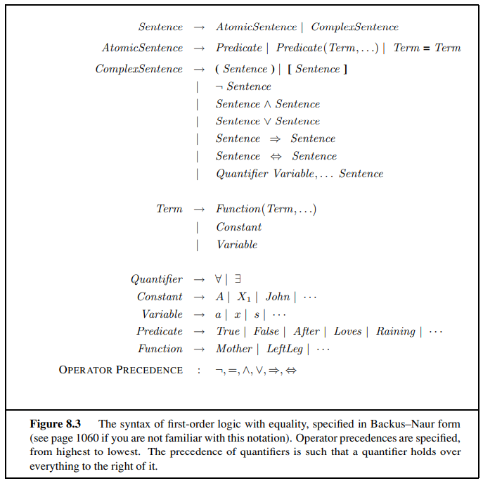
Models in first-order logic require total functions, there must be a value for every input tuple.
Thus, the crown must have a left leg and so must each of the left legs.
There is a technical solution to this awkward problem involving an additional “invisible” object that is the left leg of everything that has no left leg, including itself.
Symbols and interpretations:
The impatient reader can obtain a complete description from the formal grammar in Figure 8.3. The basic syntactic elements of first-order logic are the symbols that stand for objects, relations, and functions.
The symbols, therefore, come in three kinds: constant symbols, which stand for objects; predicate symbols, which stand for relations; and function symbols, which stand for functions.
Symbols will begin with uppercase letters.
Ex: Constant symbols Richard and John; the predicate symbols Brother , OnHead, Person, King, and Crown; and the function symbol LeftLeg.
Each predicate and function symbol comes with an arity that fixes the number of arguments

Slide 10
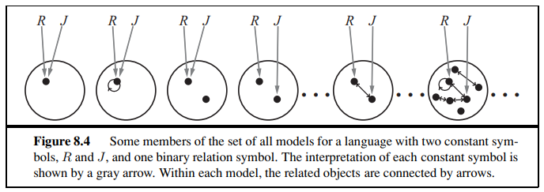
In propositional logic, every model must provide the information required to determine if any given sentence is true or false.
In addition to its objects, relations, and functions, each model includes an interpretation that specifies exactly which objects, relations and functions are referred to by the constant, predicate, and function symbols.
One possible interpretation for our example—which a logician would call the intended interpretation—is as follows:
• Richard refers to Richard the Lionheart and John refers to the evil King John.
• Brother refers to the brotherhood relation, that is, the set of tuples of objects given in Equation (8.1); OnHead refers to the “on head” relation that holds between the crown and King John; Person, King, and Crown refer to the sets of objects that are persons, kings, and crowns.
• LeftLeg refers to the “left leg” function, that is, the mapping given in Equation (8.2).
Ex: One interpretation maps Richard to the crown and John to King John’s left leg.
There are five objects in the model, so there are 25 possible interpretations just for the constant symbols Richard and John.
A model in first-order logic consists of a set of objects and an interpretation that maps constant symbols to objects, predicate symbols to relations on those objects, and function symbols to functions on those objects. To get an idea of what the set of all possible models looks like, see Figure 8.4.

Slide 11
Terms: A term is a logical expression that refers to an object.
Constant symbols are therefore terms.
Ex: In English we might use the expression “King John’s left leg” rather than giving a name to his leg.
This is what function symbols are for: instead of using a constant symbol, we use LeftLeg(John).
In the general case, a complex term is formed by a function symbol followed by a parenthesized list of terms as arguments to the function symbol.
It is important to remember that a complex term is just a complicated kind of name.
It is not a “subroutine call” that “returns a value.”
There is no LeftLeg subroutine that takes a person as input and returns a leg.
Consider a term f(t1,...,tn). The function symbol f refers to some function in the model (call it F); the argument terms refer to objects in the domain (call them d1,...,dn); and the term as a whole refers to the object that is the value of the function F applied to d1,...,dn.
LeftLeg(John) refers to King John’s left leg
Atomic sentences: Both terms for referring to objects and predicate symbols for referring to relations and put them together to make atomic sentences that state facts.
An atomic Sentence (or atom for short) is formed from a predicate symbol optionally followed by a parenthesized list of terms, such as Brother (Richard, John).
This states, under the intended interpretation given earlier, that Richard the Lionheart is the brother of King John.
Atomic sentences can have complex terms as arguments.
Thus, Married(Father (Richard), Mother (John)) states that Richard the Lionheart’s father is married to King John’s mother (again, under a suitable interpretation).
An atomic sentence is true in a given model if the relation referred to by the predicate symbol holds among the objects referred to by the arguments.
Complex sentences: Use logical connectives to construct more complex sentences, with the same syntax and semantics as in propositional calculus.
Here are four sentences that are true in the model of Figure 8.2 under our intended interpretation:
¬Brother (LeftLeg(Richard), John)
Brother (Richard, John) ∧ Brother (John, Richard)
King(Richard) ∨ King(John)
¬King(Richard) ⇒ King(John) .

Slide 12
Quantifiers: Once we have a logic that allows objects, it is only natural to want to express properties of entire collections of objects, instead of enumerating the objects by name.
First-order logic contains two standard quantifiers, called universal and existential.
Universal quantification (∀) Rules such as “Squares neighboring the wumpus are smelly” and “All kings are persons” are the bread and butter of first-order logic.
The second rule, “All kings are persons,” is written in first-order logic as ∀ x King(x) ⇒ Person(x) . ∀ is usually pronounced “For all ...”.
A variable is a term all by itself, and as such can also serve as the argument of a function—for example, LeftLeg(x).
A term with no variables is called a ground term.
Extend the interpretation in five ways:
x → Richard the Lionheart,
x → King John,
x → Richard’s left leg,
x → John’s left leg,
x → the crown.
The universally quantified sentence ∀ x King(x) ⇒ Person(x) is true in the original model if the sentence King(x) ⇒ Person(x) is true under each of the five extended interpretations
Existential quantification (∃): Universal quantification makes statements about every object. Similarly, we can make a statement about some object in the universe without naming it, by using an existential quantifier.
Ex: King John has a crown on his head, write ∃ x Crown(x) ∧ OnHead(x, John).
∃x is pronounced “There exists an x such that ...” or “For some x...”.
∃ x P says that P is true for at least one object x.
At least one of the following is true:
Richard the Lionheart is a crown ∧ Richard the Lionheart is on John’s head;
King John is a crown ∧ King John is on John’s head;
Richard’s left leg is a crown ∧ Richard’s left leg is on John’s head;
John’s left leg is a crown ∧ John’s left leg is on John’s head;
The crown is a crown ∧ the crown is on John’s head. The fifth assertion is true in the model, so the original existentially quantified sentence is true in the model. N

Slide 13
Consider the following sentence:
∃ x Crown(x) ⇒ OnHead(x, John) .
Nested quantifiers: Express more complex sentences using multiple quantifiers.
Ex: “Brothers are siblings” can be written as ∀ x ∀ y Brother (x, y) ⇒ Sibling(x, y).
Consecutive quantifiers of the same type can be written.
Siblinghood is a symmetric relationship, ∀ x, y Sibling(x, y) ⇔ Sibling(y, x) .
In other cases we will have mixtures. “Everybody loves somebody” means that for every person, there is someone that person loves: ∀ x ∃ y Loves(x, y) . On the other hand, “There is someone who is loved by everyone,” ∃ y ∀ x Loves(x, y) .
Connections between ∀ and ∃ The two quantifiers are actually intimately connected with each other, through negation.
∀ x ¬Likes(x,Parsnips ) is equivalent to ¬∃ x Likes(x,Parsnips) .
“Everyone likes ice cream” means that there is no one who does not like ice cream: ∀ x Likes(x, IceCream) is equivalent to ¬∃ x ¬Likes(x, IceCream) .
The De Morgan rules for quantified and unquantified sentences are as follows:
∀ x ¬P ≡ ¬∃ x P ¬(P ∨ Q) ≡ ¬P ∧ ¬Q
¬∀ x P ≡ ∃ x ¬P ¬(P ∧ Q) ≡ ¬P ∨ ¬Q
∀ x P ≡ ¬∃ x ¬P P ∧ Q ≡ ¬(¬P ∨ ¬Q)
∃ x P ≡ ¬∀ x ¬P P ∨ Q ≡ ¬(¬P ∧ ¬Q) .
Equality: First-order logic includes one more way to make atomic sentences, other than using a predicate and terms as described earlier.
We can use the equality symbol to signify that two terms refer to the same object.
Ex: Father (John) = Henry says that the object referred to by Father (John) and the object referred to by Henry are the same
To say that Richard has at least two brothers, we would write
∃ x, y Brother (x, Richard) ∧ Brother (y, Richard) ∧ ¬(x = y) .
The sentence
∃ x, y Brother (x, Richard) ∧ Brother (y, Richard)
does not have the intended meaning.

Slide 14
An alternative semantics?
suppose that we believe that Richard has two brothers, John and Geoffrey. Can we capture this state of affairs by asserting
Brother (John, Richard) ∧ Brother (Geoffrey, Richard) ? (8.3)
Not quite.
First, this assertion is true in a model where Richard has only one brother— we need to add John = Geoffrey.
Second, the sentence doesn’t rule out models in which Richard has many more brothers besides John and Geoffrey.
Correct translation of “Richard’s brothers are John and Geoffrey” is as follows:
Brother (John, Richard) ∧ Brother (Geoffrey, Richard) ∧ John = Geoffrey
∧ ∀x Brother (x, Richard ) ⇒ (x=John ∨ x=Geoffrey) .
USING FIRST-ORDER LOGIC
In knowledge representation, a domain is just some part of the world about which we wish to express some knowledge.
Assertions and queries in first-order logic
Sentences are added to a knowledge base using TELL, exactly as in propositional logic.
Such sentences are called assertions.
Ex: assert that John is a king, Richard is a person, and all kings are persons:
TELL(KB, King(John)) .
TELL(KB, Person(Richard)) .
TELL(KB, ∀ x King(x) ⇒ Person(x))
Ask questions of the knowledge base using ASK. Ex: ASK(KB, King(John)).
returns true. Questions asked with ASK are called queries or goals.
given the two preceding assertions, the query
ASK(KB, Person(John)) return True

Slide 15
One’s husband is one’s male spouse:
∀ w, h Husband(h,w) ⇔ Male(h) ∧ Spouse(h,w) .
Male and female are disjoint categories:
∀ x Male(x) ⇔ ￢Female(x) .
Parent and child are inverse relations:
∀ p, c Parent(p, c) ⇔ Child (c, p) .
A grandparent is a parent of one’s parent:
∀ g, c Grandparent (g, c) ⇔ ∃p Parent(g, p) ∧ Parent(p, c) .
A sibling is another child of one’s parents:
∀ x, y Sibling(x, y) ⇔ x = y ∧ ∃p Parent(p, x) ∧ Parent(p, y) .
Numbers, sets, and lists
Numbers are perhaps the most vivid example of how a large theory can be built up from a tiny kernel of axioms.
Describe here the theory of natural numbers or non-negative integers.
Need a predicate NatNum that will be true of natural numbers; need one constant symbol, 0; and need one function symbol, S (successor).
The kinship domain
Ex: Consider the domain of family relationships, or kinship.
This domain includes facts such as “Elizabeth is the mother of Charles” and “Charles is the father of William” and rules such as “One’s grandmother is the mother of one’s parent.”
Objects in our domain are people.
Two unary predicates, Male and Female.
Kinship relations—parenthood, brother hood, marriage, and so on—are represented by binary predicates: Parent, Sibling, Brother, Sister, Child , Daughter, Son, Spouse, Wife, Husband, Grandparent, Grandchild, Cousin, Aunt, and Uncle.
Use functions for Mother and Father, because every person has exactly one of each of these go through each function and predicate, writing down what we know in terms of the other symbols.
Ex: one’s mother is one’s female parent:
∀ m, c Mother (c)=m ⇔ Female(m) ∧ Parent(m, c)

Slide 16
The Peano axioms define natural numbers and addition. Natural numbers are defined recursively:
NatNum(0) .
∀ n NatNum(n) ⇒ NatNum(S(n)) .
0 is a natural number, and for every object n, if n is a natural number, then S(n) is a natural number.
Natural numbers are 0, S(0), S(S(0)), and so on.
need axioms to constrain the successor function:
∀ n 0 = S(n) .
∀ m, n m = n ⇒ S(m) = S(n) .
Can define addition in terms of the successor function:
∀m NatNum(m) ⇒ + (0,m) = m
∀ m, n NatNum(m) ∧ NatNum(n) ⇒ + (S(m), n) = S(+(m, n))
The first of these axioms says that adding 0 to any natural number m gives m itself.
Use of the binary function symbol “+” in the term +(m, 0); in ordinary mathematics, the term would be written m + 0 using infix notation
To make our sentences about numbers easier to read, allow the use of infix notation.
Write S(n) as n+ 1, second axiom becomes
∀ m, n NatNum(m) ∧ NatNum(n) ⇒ (m + 1) + n = (m + n) + 1 .
It reduces addition to repeated application of the successor function.
The domain of sets is also fundamental to mathematics as well as to commonsense reasoning.
Build up sets by adding an element to a set or taking the union or intersection of two sets.
The empty set is a constant written as {}.
There is one unary predicate, Set, which is true of sets.
The binary predicates are x∈ s (x is a member of set s) and s1 ⊆ s2 (set s1 is a subset, not necessarily proper, of set s2).

Slide 17
Lists are similar to sets.
The differences are that lists are ordered and the same element can appear more than once in a list.
We can use the vocabulary of Lisp for lists: Nil is the constant list with no elements; Cons, Append, First, and Rest are functions; and Find is the predicate that does for lists what Member does for sets The empty list is [ ].
The term Cons(x, y), where y is a nonempty list, is written [x|y].
The term Cons(x, Nil)
The wumpus world
Some propositional logic axioms for the wumpus world were given.
The corresponding first-order sentence stored in the knowledge base must include both the percept and the time at which it occurred; use integers for time steps.
A typical percept sentence would be Percept ([Stench, Breeze, Glitter , None, None], 5)
Percept is a binary predicate, and Stench and so on are constants placed in a list.
The actions in the wumpus world can be represented by logical terms:
Turn(Right ), Turn(Left ), Forward , Shoot , Grab, Climb .
To determine which is best, the agent program executes the query
ASKVARS(∃ a BestAction(a, 5)) ,
which returns a binding list such as {a/Grab}. The agent program can then return Grab as
the action to take.
The raw percept data implies certain facts about the current state. Ex:
∀ t, s, g, m, c Percept ([s, Breeze, g,m, c], t) ⇒ Breeze(t) ,
∀ t, s, b, m, c Percept ([s, b, Glitter,m, c], t) ⇒ Glitter (t) ,
and so on. These rules exhibit a trivial form of the reasoning process called perception.

Slide 18
Quantification over time t.
In propositional logic, need copies of each sentence for each time step.
Simple “reflex” behavior can also be implemented by quantified implication sentences.
Ex:∀ t Glitter (t) ⇒ BestAction(Grab, t)
It is better to use a complex term in which the row and column appear as integers; for example, we can simply use the list term [1, 2].
Adjacency of any two squares can be defined as
∀ x, y, a, b Adjacent ([x, y], [a, b]) ⇔
(x = a ∧ (y = b − 1 ∨ y = b + 1)) ∨ (y = b ∧ (x = a − 1 ∨ x = a + 1)) .
It is simpler to use a unary predicate Pit that is true of squares containing pits.
There is exactly one wumpus, a constant Wumpus is just as good as a unary predicate
At(Agent, s, t) to mean that the agent is at square s at time t.
Fix the wumpus’s location with ∀t At(Wumpus, [2, 2], t).
Objects can only be at one location at a time:
∀ x, s1, s2, t At(x, s1, t) ∧ At(x, s2, t) ⇒ s1 = s2 .
Ex: if the agent is at a square and perceives a breeze, then that square is breezy:
∀ s, t At(Agent, s, t) ∧ Breeze(t) ⇒ Breezy(s)
a square is breezy because we know that the pits cannot move about first-order logic just needs one axiom:
∀ s Breezy(s) ⇔ ∃r Adjacent (r, s) ∧ Pit(r) . (8.4)
Ex: axiom for the arrow (Equation (7.2) on page 267) becomes
∀ t HaveArrow(t + 1) ⇔ (HaveArrow(t) ∧￢Action(Shoot, t)) .

Slide 19
KNOWLEDGE ENGINEERING IN FIRST-ORDER LOGIC
Use of first-order logic to represent knowledge in three simple domains.
General process of knowledge-base construction— a process called knowledge engineering.
A knowledge engineer is someone who investigates a particular domain, learns what concepts are important in that domain, and creates a formal representation of the objects and relations in the domain.
The knowledge-engineering process
Knowledge engineering projects vary widely in content, scope, and difficulty, but all such projects include the following steps:
1. Identify the task: The knowledge engineer must delineate the range of questions that the knowledge base will support and the kinds of facts that will be available for each specific problem instance.
Ex: does the wumpus knowledge base need to be able to choose actions or is it required to answer questions only about the contents of the environment?
2. Assemble the relevant knowledge. The knowledge engineer might already be an expert in the domain, or might need to work with real experts to extract what they know—a process called knowledge acquisition. At this stage, the knowledge is not represented formally. The idea is to understand the scope of the knowledge base, as determined by the task, and to understand how the domain actually works.3.
3. Decide on a vocabulary of predicates, functions, and constants. That is, translate the important domain-level concepts into logic-level names.

Slide 20

4. Encode general knowledge about the domain. The knowledge engineer writes down the axioms for all the vocabulary terms.
5. Encode a description of the specific problem instance. If the ontology is well thought out, this step will be easy.
6.Pose queries to the inference procedure and get answers. This is where the reward is: we can let the inference procedure operate on the axioms and problem-specific facts to derive the facts we are interested in knowing.
7. Debug the knowledge base. Alas, the answers to queries will seldom be correct on the first try. More precisely, the answers will be correct for the knowledge base as written, assuming that the inference
procedure is sound, but they will not be the ones that the user is expecting.
Ex: If the knowledge base includes a diagnostic rule (see Exercise 8.13) for finding the wumpus, ∀ s Smelly(s) ⇒ Adjacent(Home(Wumpus), s) , instead of the biconditional, then the agent will never be able to prove the absence of wumpuses. Incorrect axioms can be identified because they are false statements about the world.
Encode general knowledge of the domain One sign that we have a good ontology is that we require only a few general rules, which can be stated clearly and concisely. These are all the axioms we will need:
1. If two terminals are connected, then they have the same signal: ∀ t1, t2 Terminal(t1) ∧ Terminal(t2) ∧ Connected(t1, t2) ⇒ Signal(t1) = Signal(t2) .

Slide 21
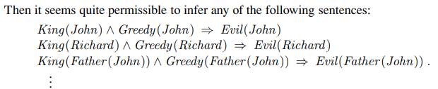

2. The signal at every terminal is either 1 or 0: ∀ t Terminal(t) ⇒ Signal(t)=1 ∨ Signal(t)=0
3. Connected is commutative: ∀ t1, t2 Connected(t1, t2) ⇔ Connected(t2, t1) .
INFERENCE IN FIRST-ORDER LOGIC
Three major families of first-order inference algorithms. Forward chaining and its applications to deductive databases and production systems; backward chaining and logic programming systems are developed; Forward and backward chaining can be very efficient, but are applicable only to knowledge bases that can be expressed as sets of Horn clauses.
PROPOSITIONAL VS. FIRST-ORDER INFERENCE
Introduce the ideas underlying modern logical inference systems.
Begin with some simple inference rules that can be applied to sentences with quantifiers to obtain sentences without quantifiers.
First-order inference can be done by converting the knowledge base to propositional logic and using propositional inference
Inference rules for quantifiers Let us begin with universal quantifiers. Suppose our knowledge base contains the standard folkloric axiom stating that all greedy kings are evil: ∀ x King(x) ∧ Greedy(x) ⇒ Evil(x)
The rule of Universal Instantiation (UI) says that we can infer any sentence obtained by substituting a ground term (a term without variables) for the variable.
To write out the inference rule formally, we use the notion of substitutions introduced. Let SUBST(θ,α) denote the result of applying the substitution θ to the sentence α. Then the rule is written

Slide 22
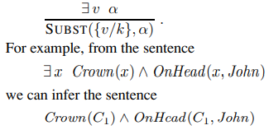


for any variable v and ground term g. Ex: the three sentences given earlier are obtained with the substitutions {x/John}, {x/Richard}, and {x/Father (John)}.
In the rule for Existential Instantiation, the variable is replaced by a single new con- stant symbol. The formal statement is as follows: for any sentence α, variable √, and constant symbol k that does not appear elsewhere in the knowledge base
as long as C1 does not appear elsewhere in the knowledge base. Basically, the existential sentence says there is some object satisfying a condition, and applying the existential instantiation rule just gives a name to that object.
Reduction to propositional inference
If rules for inferring non-quantified sentences from quantified sentences, it becomes possible to reduce first-order inference to propositional inference.
Existentially quantified sentence can be replaced by one instantiation, a universally quantified sentence can be replaced by the set of all possible instantiations.
Ex: suppose our knowledge base contains just the sentences
--- 9.1
apply UI to the first sentence using all possible ground-term substitutions from the vocabulary of the knowledge base—in this case, {x/John} and {x/Richard}. We obtain

Slide 23

Discard the universally quantified sentence.
knowledge base is essentially propositional if we view the ground atomic sentences—King (John), Greedy(John).
Apply any of the complete propositional algorithms to obtain conclusions such as Evil(John)
UNIFICATION AND LIFTING
Propositionalization approach is rather inefficient.
Ex: given the query Evil(x) and the knowledge base in Equation (9.1), it seems perverse to generate sentences such as
King(Richard) ∧ Greedy(Richard) ⇒ Evil(Richard).
Indeed, the inference of Evil(John) from the sentences
∀ x King(x) ∧ Greedy(x) ⇒ Evil(x)
King(John)
Greedy(John)
A first-order inference rule:
The inference that John is evil—that is, that {x/John} solves the query Evil(x)—works like this:
to use the rule that greedy kings are evil, find some x such that x is a king and x is greedy, and then infer that this x is evil.
If there is some substitution θ that makes each of the conjuncts of the premise of the implication identical to sentences already in the knowledge base, then we can assert the conclusion of the implication, after applying θ.
The substitution θ = {x/John} achieves that aim.
Suppose that instead of knowing Greedy(John), we know that everyone is greedy: ∀ y Greedy(y) .
Then we would still like to be able to conclude that Evil(John), because we know that John is a king (given) and John is greedy.
Generalized Modus Ponens: For atomic sentences p_{i}, p_{i}’, and q, where there is a substitution θ such that SUBST(θ, p_{i}‘) = SUBST(θ, pi), for all i

Slide 24
There are n+ 1 premises to this rule: the n atomic sentences p_{i} and the one implication.
The conclusion is the result of applying the substitution θ to the consequent q.
Ex: p₁’ is King(John) p₁ is King(x)
p₂’is Greedy(y) p₂ is Greedy(x)
θ is {x/John, y/John} q is Evil(x)
SUBST(θ, q) is Evil(John) .
It is easy to show that Generalized Modus Ponens is a sound inference rule.
For any sentence p (whose variables are assumed to be universally quantified) and for any substitution θ,
p |= SUBST(θ, p)
holds by Universal Instantiation.
It holds in particular for a θ that satisfies the conditions of the Generalized Modus Ponens rule.
Thus, from p₁ ,...,p_{n} we can infer SUBST(θ, p₁ ) ∧ ... ∧ SUBST(θ, p_{n} ) and from the implication p₁ ∧ ... ∧ p_{n} ⇒ q we can infer
SUBST(θ, p₁) ∧ ... ∧ SUBST(θ, p_{n}) ⇒ SUBST(θ, q)
Now, θ in Generalized Modus Ponens is defined so that SUBST(θ, p_{i}’ ) = SUBST(θ, pi), for all i;
First of these two sentences matches the premise of the second exactly. Hence, SUBST(θ, q) follows by Modus Ponens.
Generalized Modus Ponens is a lifted version of Modus Ponens—it raises Modus Ponens from ground (variable-free) propositional logic to first-order logic.
UNIFICATION:
Lifted inference rules require finding substitutions that make different logical expressions look identical.
This process is called unification and is a key component of all first-order inference algorithms.
The UNIFY algorithm takes two sentences and returns a unifier for them if one exists: UNIFY(p, q) = θ where SUBST(θ, p) = SUBST(θ, q) .
Ex: Suppose we have a query AskVars(Knows(John, x)): whom does John know? Answers to this query can be found.
by finding all sentences in the knowledge base that unify with Knows(John, x). Here are the results of unification with four different sentences that might be in the knowledge base:
UNIFY(Knows(John, x), Knows(John, Jane)) = {x/Jane} UNIFY(Knows(John, x), Knows(y, Bill)) = {x/Bill, y/John} UNIFY(Knows(John, x), Knows(y, Mother (y))) = {y/John, x/Mother (John)}
UNIFY(Knows(John, x), Knows(x, Elizabeth)) = fail

Slide 25
The last unification fails because x cannot take on the values John and Elizabeth at the same time.
Knows(x, Elizabeth) means “Everyone knows Elizabeth,” it infers that John knows Elizabeth.
FORWARD CHAINING: start with the atomic sentences in the knowledge base and apply Modus Ponens in the forward direction, adding new atomic sentences, until no further inferences can be made.
Definite clauses such as Situation ⇒ Response are especially useful for systems that make inferences in response to newly arrived information
First-order definite clauses: First-order definite clauses closely resemble propositional definite clauses they are disjunctions of literals of which exactly one is positive.
A definite clause either is atomic or is an implication whose antecedent is a conjunction of positive literals and whose consequent is a single positive literal
King(x) ∧ Greedy(x) ⇒ Evil(x)
King(John)
Greedy(y)
Unlike propositional literals, first-order literals can include variables, in which case those variables are assumed to be universally quantified.
The law says that it is a crime for an American to sell weapons to hostile nations.
The country Nono, an enemy of America, has some missiles, and all of its missiles were sold to it by Colonel West, who is American, prove that West is a criminal.
Represent these facts as first-order definite clauses.
forward-chaining algorithm solves the problem
“... it is a crime for an American to sell weapons to hostile nations”:
American(x) ∧ Weapon(y) ∧ Sells(x, y, z) ∧ Hostile(z) ⇒ Criminal(x) …. (9.3)
“Nono ... has some missiles.”

Slide 26
The sentence ∃ x Owns(Nono, x)∧Missile(x) is transformed into two definite clauses by Existential Instantiation, introducing a new constant M1:
Owns(Nono, M1) (9.4)
Missile . (M1) (9.5)
“All of its missiles were sold to it by Colonel West”:
Missile(x) ∧ Owns(Nono, x) ⇒ Sells(West, x, Nono) . (9.6)
We will also need to know that missiles are weapons:
Missile(x) ⇒ Weapon(x) (9.7)
and we must know that an enemy of America counts as “hostile”:
Enemy(x, America) ⇒ Hostile(x) . (9.8)
“West, who is American ...”:
American(West) . (9.9)
“The country Nono, an enemy of America ...”:
Enemy(Nono, America) . (9.10)
This knowledge base contains no function symbols and is therefore an instance of the class of Datalog knowledge bases
A simple forward-chaining algorithm:
The first forward-chaining algorithm we consider is a simple one, shown in Figure 9.3.
Starting from the known facts, it triggers all the rules whose premises are satisfied, adding their conclusions to the known facts.
The process repeats until the query is answered (assuming that just one answer is required) or no new facts are added.
Notice that a fact is not “new” if it is just a renaming of a known fact.
One sentence is a renaming of another if they are identical except for the names of the variables.
Ex: Likes(x, IceCream) and Likes(y, IceCream) are renamings of each other because they differ only in the choice of x or y; their meanings are identical: everyone likes ice cream.
We use our crime problem to illustrate how FOL-FC-ASK works.

Slide 27
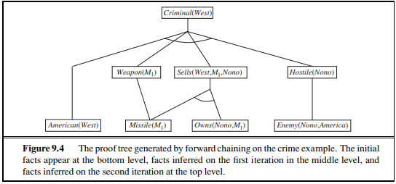
The implication sentences are (9.3), (9.6), (9.7), and (9.8).
Two iterations are required:
• On the first iteration, rule (9.3) has unsatisfied premises.
Rule (9.6) is satisfied with {x/M1}, and Sells(West, M1, Nono) is added.
Rule (9.7) is satisfied with {x/M1}, and Weapon(M1) is added.
Rule (9.8) is satisfied with {x/Nono}, and Hostile(Nono) is added.
• On the second iteration, rule (9.3) is satisfied with {x/West, y/M1, z/Nono}, and Criminal(West) is added.
Figure 9.4 shows the proof tree that is generated.
Efficient forward chaining
A backward-chaining algorithm Figure 9.6 shows a backward-chaining algorithm for definite clauses.
FOL-BC-ASK(KB, goal) will be proved if the knowledge base contains a clause of the form lhs ⇒ goal, where lhs (left-hand side) is a list of conjuncts.
An atomic fact like American(West) is considered as a clause whose lhs is the empty list.
Now a query that contains variables might be proved in multiple ways. For example, the query Person(x) could be proved with the substitution {x/John} as well as with {x/Richard}.
So we implement FOL-BC-ASK as a generator— a function that returns multiple times, each time giving one possible result.
Backward chaining is a kind of AND/OR search—the OR part because the goal query can be proved by any rule in the knowledge base, and the AND part because all the conjuncts in the lhs of a clause must be proved.

Slide 28
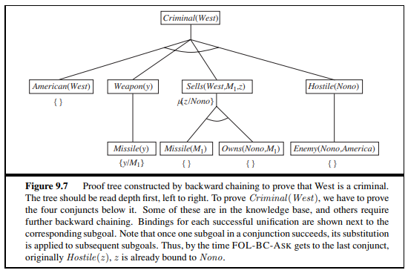
Figure 9.7 is the proof tree for deriving Criminal(West) from sentences (9.3) through (9.10).
RESOLUTION
The last of our three families of logical systems is based on resolution.
Propositional resolution using refutation is a complete inference procedure for propositional logic.
How to extend resolution to first-order logic.
Conjunctive normal form for first-order logic: As in the propositional case, first-order resolution requires that sentences be in conjunctive normal form (CNF)—that is, a conjunction of clauses, where each clause is a disjunction of literals.
Literals can contain variables, which are assumed to be universally quantified.
Ex: The sentence
∀ x American(x) ∧ Weapon(y) ∧ Sells(x, y, z) ∧ Hostile(z) ⇒ Criminal(x) becomes, in CNF,
¬American(x) ∨ ¬Weapon(y) ∨ ¬Sells(x, y, z) ∨ ¬Hostile(z) ∨ Criminal(x)
Every sentence of first-order logic can be converted into an inferentially equivalent CNF sentence.
CNF sentence will be unsatisfiable just when the original sentence is unsatisfiable, so we have a basis for doing proofs by contradiction on the CNF sentences

Slide 29
The procedure for conversion to CNF is similar to the propositional case.
The principal difference arises from the need to eliminate existential quantifiers.
We illustrate the procedure by translating the sentence “Everyone who loves all animals is loved by someone,” or
∀ x [∀ y Animal(y) ⇒ Loves(x, y)] ⇒ [∃ y Loves(y, x)]
The steps are as follows:
• Eliminate implications:
∀ x [¬∀ y ¬Animal(y) ∨ Loves(x, y)] ∨ [∃ y Loves(y, x)]
• Move ¬ inwards: In addition to the usual rules for negated connectives, we need rules for negated quantifiers.
Thus, we have ¬∀ x p becomes ∃ x ¬p
¬∃ x p becomes ∀ x ¬p.
Our sentence goes through the following transformations:
∀ x [∃ y ¬(¬Animal(y) ∨ Loves(x, y))] ∨ [∃ y Loves(y, x)]
∀ x [∃ y ¬¬Animal(y) ∧ ¬Loves(x, y)] ∨ [∃ y Loves(y, x)]
∀ x [∃ y Animal(y) ∧ ¬Loves(x, y)] ∨ [∃ y Loves(y, x)]
Notice how a universal quantifier (∀ y) in the premise of the implication has become an existential quantifier.
The sentence now reads “Either there is some animal that x doesn’t love, or (if this is not the case) someone loves x.
Standardize variables: For sentences like (∃ x P(x))∨(∃ x Q(x)) which use the same variable name twice, change the name of one of the variables.
This avoids confusion later when we drop the quantifiers.
∀ x [∃ y Animal(y) ∧ ¬Loves(x, y)] ∨ [∃ z Loves(z, x)]
• Skolemize: Skolemization is the process of removing existential quantifiers by elimination.
Translate ∃ x P(x) into P(A), where A is a new constant.
Can’t apply Existential Instantiation to our sentence above because it doesn’t match the pattern ∃ v α; only parts of the sentence match the pattern.
If we blindly apply the rule to the two matching parts we get
∀ x [Animal(A) ∧ ¬Loves(x, A)] ∨ Loves(B,x)
which has the wrong meaning entirely: it says that everyone either fails to love a particular animal A or is loved by some particular entity B
• Drop universal quantifiers: At this point, all remaining variables must be universally quantified.
Sentence is equivalent to one in which all the universal quantifiers have been moved to the left.
Drop the universal quantifiers:
[Animal(F(x)) ∧ ¬Loves(x, F(x))] ∨ Loves(G(z), x)
• Distribute ∨ over ∧:
[Animal(F(x)) ∨ Loves(G(z), x)] ∧ [¬Loves(x, F(x)) ∨ Loves(G(z), x)]
This step may also require flattening out nested conjunctions and disjunctions

Slide 30
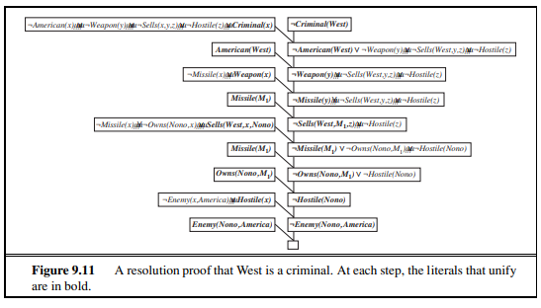
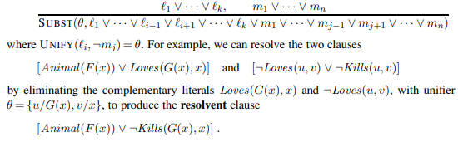
The resolution inference rule:
The resolution rule for first-order clauses is simply a lifted version of the propositional resolution rule.
Two clauses, which are assumed to be standardized apart so that they share no variables, can be resolved if they contain complementary literals.
Propositional literals are complementary if one is the negation of the other; first-order literals are complementary if one unifies with the negation of the other. This rule is called the binary resolution rule because it resolves exactly two literals.
Example proofs Resolution proves that KB |= α by proving KB ∧ ¬α unsatisfiable, that is, by deriving the empty clause.
Figure 7.12, so we need not repeat it here. Instead, we give two example proofs. The first is the crime example from Section 9.3.

Slide 31
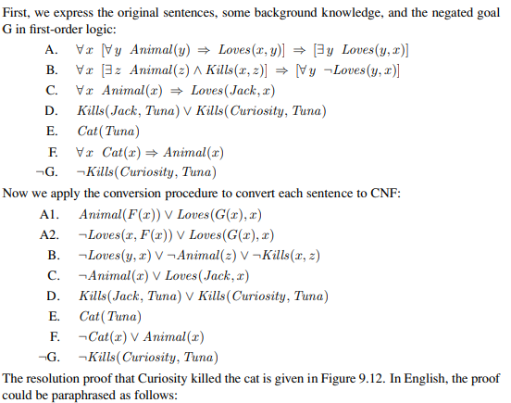
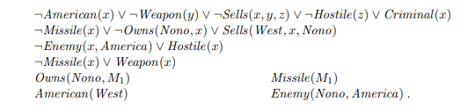
The sentences in CNF are
We also include the negated goal ¬Criminal(West).
This results in a somewhat more complex proof structure. In English, the problem is as follows: Everyone who loves all animals is loved by someone.
Anyone who kills an animal is loved by no one. Jack loves all animals.
Either Jack or Curiosity killed the cat, who is named Tuna. Did Curiosity kill the cat?

Slide 32
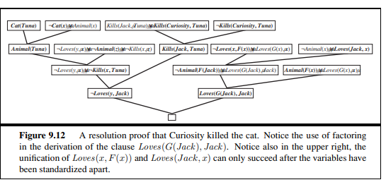
Suppose Curiosity did not kill Tuna. We know that either Jack or Curiosity did; thus Jack must have. Now, Tuna is a cat and cats are animals, so Tuna is an animal. Because anyone who kills an animal is loved by no one, we know that no one loves Jack. On the other hand, Jack loves all animals, so someone loves him; so we have a contradiction. Therefore, Curiosity killed the cat

